Slide 1
4
The future of apps
4
The future of apps
Hardik Mistry
Technology Consultant, Mobility & Cloud
@mistryhardik05

Slide 2

Who is this guy?
Hardik Mistry
Technology Consultant, Mobility & Cloud
mistryhardik.05@live.com
@mistryhardik05

Slide 3



I have a question for you.
What device do you have?
Notes:
Audience participation – ask them to hold up their devices based on type – Windows Phone, iPhone, Apple.
How does it make you feel, do you identify with it and can you engage in a discussion about it with others?
Images from: http://www.titanui.com/5926-galaxy-s3-lumia-920-and-iphone-5-mockup-psd/

Slide 4

People are passionate about their device.
Notes:
The point I am making is that for many people the device they choose to have is almost an extension of their person and they feel very passionate about it.
To the point, sometimes, that a bad words might be fighting words.
* Play video *
Note after the video that you love that in half way through it has “do not attempt” in small font at the bottom of the screen.

Slide 5

People are passionate about their device.
Notes:
The point I am making is that for many people the device they choose to have is almost an extension of their person and they feel very passionate about it.
To the point, sometimes, that a bad words might be fighting words.
* Play video *
Note after the video that you love that in half way through it has “do not attempt” in small font at the bottom of the screen.

Slide 6
Why business cares.
BYOD

Slide 7
Why business cares.
50%
(2017)
Notes:
Globally, half of employers will require BYOD by 2017.
Ask audience who works at a business where they BYOD (even unofficially).
3: Bring Your Own Device: The Facts and the Future: http://www.gartner.com/DisplayDocument?id=2422315
- Consumption of video on mobile devices for work purposes.
- By 2014 90% of organisations will support corporate apps on a range of personal devices.

Slide 8
Why business cares.
60%
(2015)
Notes:
Over 60% of Information Workers will interact with content applications via a mobile device by 2015.
How to Take Video Mobile With Enterprise Video Content Management: http://www.gartner.com/DisplayDocument?id=2516615

Slide 9
Why business cares.
50%
(2016)
Notes:
By 2016 half of these initiatives will have failed due to lack of true BYOD support.
How to Take Video Mobile With Enterprise Video Content Management: http://www.gartner.com/DisplayDocument?id=2516615

Slide 10

Didn’t HTML5 solve this?
Complicates build for some use cases.
Patchy or varied support for some features cross-browser or webview.
Notes:
Use cases that are complicated by HTML5:
Capture signature.
Long duration offline support.
Intermittent loss of connectivity or high latency connections resulting in poor user experience.
Data Encryption.
Monetisation.
Examples of patchy support:
localStorage, sessionStorage or globalStorage vary between browser / WebView. http://dev-test.nemikor.com/web-storage/support-test/
Apple breaks localStorage & WebSQL in iOS 5.1 WebView. http://www.sencha.com/blog/html5-scorecard-the-new-ipad-and-ios-5-1/#date:15:00

Slide 11
What are the top 2 mobile browsers?
Safari
Android Webkit
Notes:
Surprisingly Chrome is not the most used.
Source Akamai I/O (http://www.akamai.com/html/io/io_dataset.html#stat=mobile_browser&top=5&type=line&start=20130627&end=20130727&net=both) confirm this tend.
Ever heard ofAndroid Webkit? It’s the default browser that ships with the majority of Android-based handsets and differs from Chrome which is only just starting to ship with higher end devices.

Slide 12
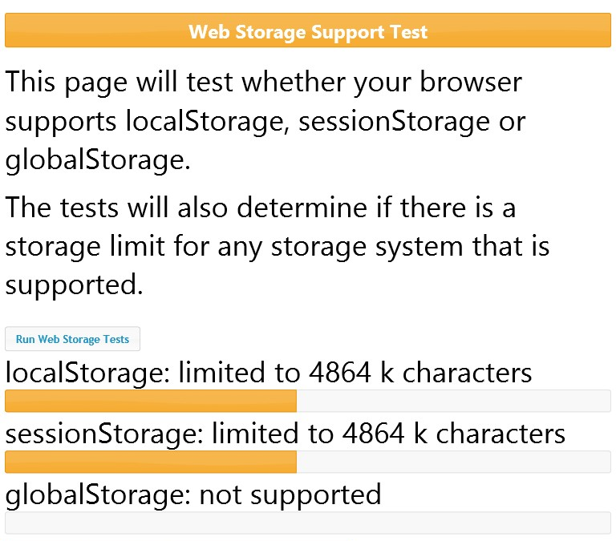
Windows Phone 8

Slide 13
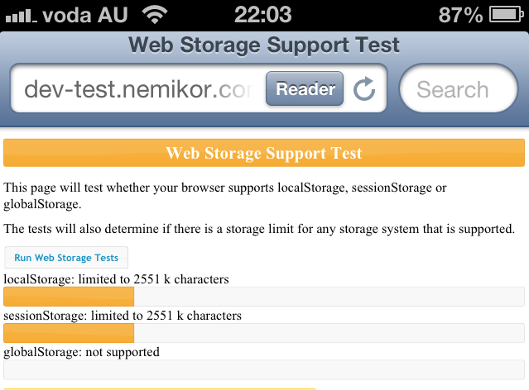
iOS 6
Notes:
Note on iOS 5.0.1 storage problem.

Slide 14
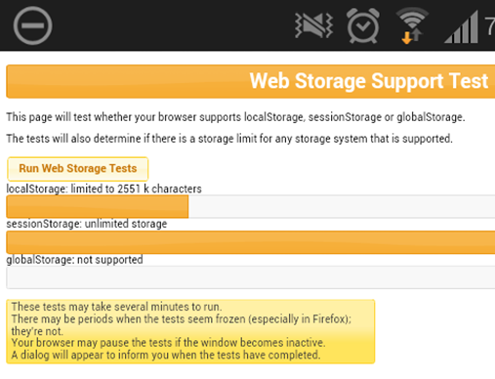
Android 4.1.2
Notes:
Everyone assumes that Android’s default browser is Chrome – it’s not. It’s the Android browser and it hasn’t been heavily developed since 2011. Some devices have replaced it with Chrome but it tends to be only flagship devices.
http://www.mobilexweb.com/blog/android-browser-eternal-dying

Slide 15
HTML5 lessons learned
“I think the biggest mistake that we made, as a company, is betting too much on HTML5 as opposed to native...” – Mark Zuckerberg, Facebook
“We have definitely shifted from HTML5 to native. The primary reason for that is .. people are spending more time in the app, and the app is running out of memory…” – Kiran Prasad, LinkedIn
Notes:
Don’t forget the last animation over HTML5 logo.
Key thought leaders in online applications are committing to build native experiences because of the patchy cross-device HTML5 support.
Zuckerberg quote from TechCrunch Disrupt SF September 2012.
Kiran Prasad LinkedIn’s senior director for mobile engineering (April 2013) - http://venturebeat.com/2013/04/17/linkedin-mobile-web-breakup/

Slide 16
Which leaves us with?
Going native!
Notes:
Mockup sources: http://www.titanui.com/5926-galaxy-s3-lumia-920-and-iphone-5-mockup-psd/

Slide 17
X-Platform C# & Xamarin

Slide 18
C# is not just for Christmas
An international standard governed by both ECMA (2001) and ISO (2003).
Underlying Common Language Infrastructure (CLI) is also standardised via ECMA and ISO.
Write your own! Are you up for some weekend hacking?
Notes:
ECMA = European Computer Manufacturers Association
The ISO standard comes in at 531 pages covering all aspects of the C# language.
http://www.ecma-international.org/publications/standards/Ecma-334.htm
The CLI includes Intermediate Langauge (CIL) definitions and the Common Language Runtime.
The runtime or Microsoft CLR is also based on an open standard for Common Language Infrastructure (CLI) though in the case of this talk the CLI isn’t applicable. ISO/IEC 23271:2012 & ECMA-335
Microsoft is also open sourcing parts of their stack above C# and the CLI. See releases for ASP.Net MVC including Web API and Web Pages and Razor (Codeplex) http://aspnetwebstack.codeplex.com/, SignalR (Github) and Entity Framework (Codeplex).

Slide 19




Getting up to monkey business
The history of Mono
Mono licensed by Novell
bought by (2003)
bought by (2011)
Xamarin
(2011)
Ximian
(1999)
started
shipped
laid off team
started
shipped
(2001)
v1.0 (2004) v2.0 (2008) Touch (2009)
Droid (2011) v3.0 (2012)
?? (2011)
Notes:
Miguel de Icaza and Nat Friedman

Slide 20
.Net and Mono compatibility
.Net 4.0 except WPF, WWF, and with limited WCF.
ASP.Net, MVC3 and Razor.
C# 5.0 async support since July 2013.
Notes:
Access to Generics, Async methods and a lot of goodness.
On mobile platforms there are some restrictions due to the code being pre-compiled into executatbles (ahead of time / AOT) compilation.
Good information on Xamarin site around know limitations for iOS and Android:
http://docs.xamarin.com/guides/android/advanced_topics/limitations
http://docs.xamarin.com/guides/ios/advanced_topics/limitations
If you are a games developer these is also support for Cocos2D that has been ported to C#.

Slide 21
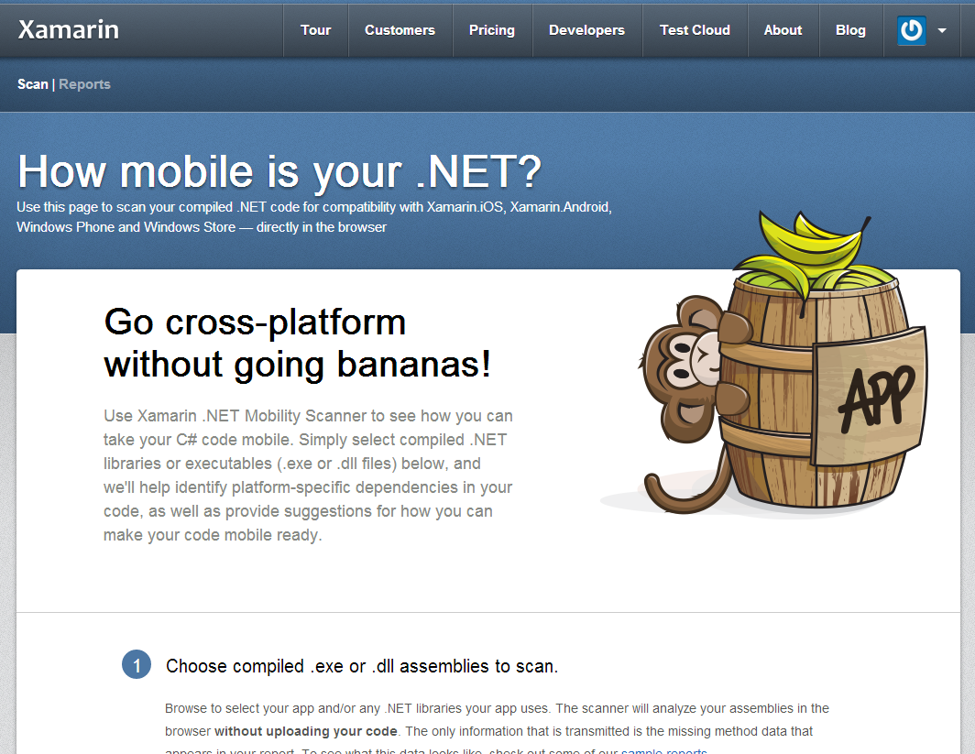
Scan your code

Slide 22
Native mobile platforms support
iOS: AOT used to build a native ARM app.
Android: Compiled to IL and packaged with MonoVM.
Objective-C: utilise P/Invoke.
Java: use Java Binding Library or JNI.
Notes:
ANDROID: sits on top of Linux Kernel of device. Leverage Dalvik Java APIs where required.
Access JAR files by creating a Java Binding Library project in

Slide 23
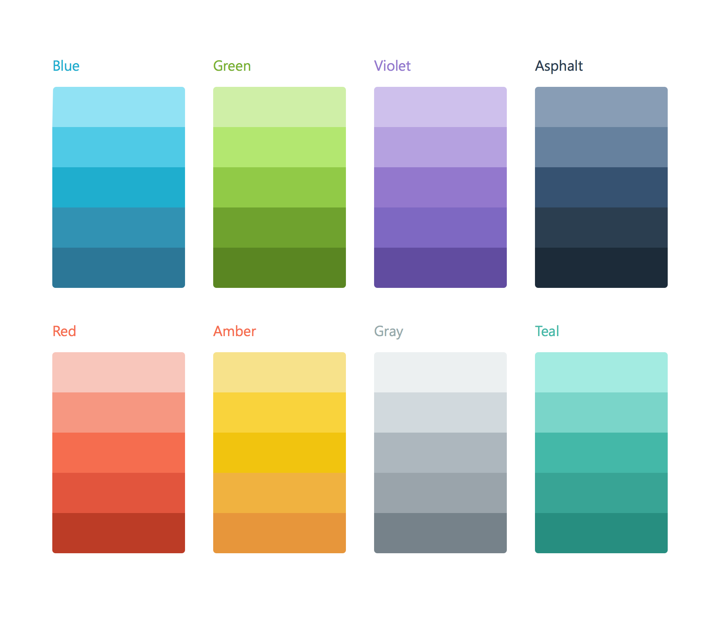
Xamarin’s Mission
Make it fast, easy, and fun to create great mobile apps.

Slide 24
Your priorities when building apps
Native
5-Star App
Works Everywhere
Integration
Stay current

Slide 25
Xamarin 4
Enterprise-grade
Complete
mobile lifecycle

Slide 26
Xamarin – Your Complete Mobile Solution
BUILD
TEST
MONITOR
ACCELERATE
Notes:
Xamarin is your complete mobile solution.
Xamarin Platform is usually what you hear about which is building native iOS, Android, Mac, and Windows Apps all in C#
However Xamarin offers a wide range of products for developers to go mobile including Test Cloud, Insights, and a way to learn all of mobile with University.

Slide 27
Xamarin 4: the complete mobile lifecycle
BUILD
TEST
MONITOR
ACCELERATE
Notes:
Xamarin is your complete mobile solution.
Xamarin Platform is usually what you hear about which is building native iOS, Android, Mac, and Windows Apps all in C#
However Xamarin offers a wide range of products for developers to go mobile including Test Cloud, Insights, and a way to learn all of mobile with University.

Slide 28
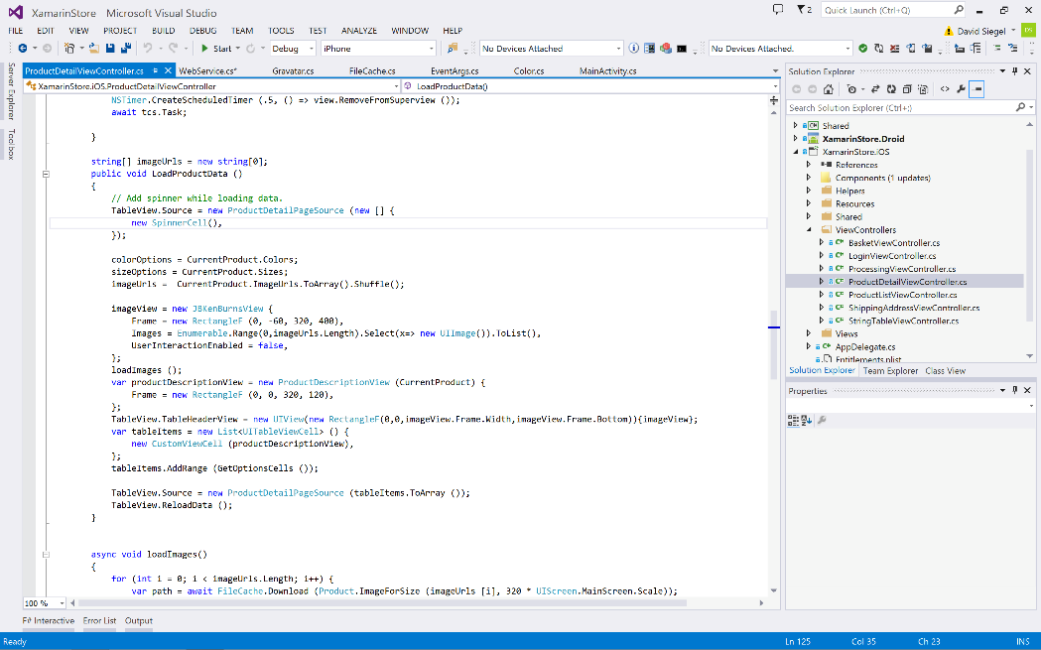
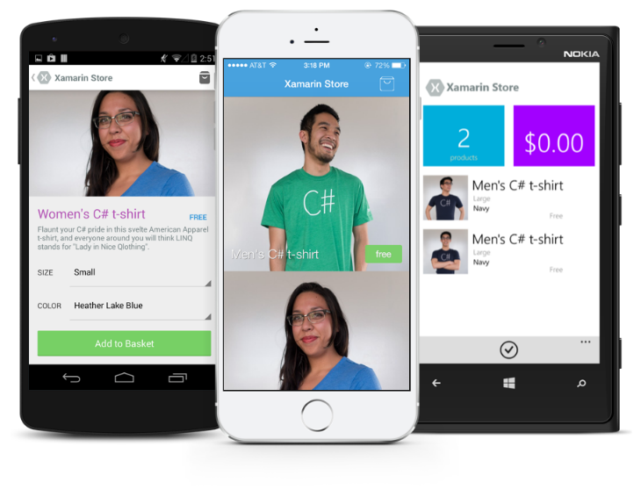
Xamarin Platform: native apps across platforms

Slide 29
Xamarin’s Unique Approach
iOS C# UI
Android C# UI
Windows C# UI
Shared C# Mobile
Shared C# codebase • 100% native API access • High performance
Notes:
UI build natively per platform, leveraging C#
C# + XAML
C# + XML
C# + XIB
One shared app logic code base, iOS, Android, Mac, Windows Phone, Windows Store, Windows

Slide 30
Xamarin + Xamarin.Forms
iOS C# UI
Android C# UI
Windows C# UI
Shared UI Code
Shared C# Backend
Shared C# Backend
Traditional Xamarin Approach
With Xamarin.Forms: More code-sharing, all native
Notes:
Xamarin recently introduced Xamarin.Forms a new library for cross platform user interface. We will touch up on this later, but this enables you to be highly productive, share code, but build out UI on each platform and access platform APIs.
With Xamarin.Forms you now have a nice Shared UI Code layer, but still access to platform APIs
You can start from native, pick a few screens, or start with forms, and replace with native later

Slide 31
Windows APIs
Microsoft.Phone
Microsoft.Networking
Windows.Storage
Windows.Foundation
Microsoft.Devices
System.Net
System
System.IO
System.Linq
System.Xml
System.Data
System.Windows
System.Numerics
System.Core
System.ServiceModel
Notes:
If you have ever developed for a Windows Platform before these .NET namespaces might look familiar.
However, if we go to a new platform such as Windows Phone or Store we have a new SDK to use and a new set of namespaces.

Slide 32
iOS – 100% API Coverage
MapKit
UIKit
iBeacon
CoreGraphics
CoreMotion
System.Net
System
System.IO
System.Linq
System.Xml
System.Data
System.Windows
System.Numerics
System.Core
System.ServiceModel
Notes:
You can think of iOS and Android development the same with Xamarin. You can see we have all of our .NET namespaces and libraries, but Xamarin give us 100% api coverage of each iOS API in it’s SDK that we access view C#.

Slide 33
Android – 100% API Coverage
Text-to-speech
ActionBar
Printing Framework
Renderscript
NFC
System.Net
System
System.IO
System.Linq
System.Xml
System.Data
System.Windows
System.Numerics
System.Core
System.ServiceModel
Notes:
The same is true for Android as well.

Slide 34
Anything you can do in Objective-C, Swift, or Java can be done in C# and Visual Studio with Xamarin.

Slide 35
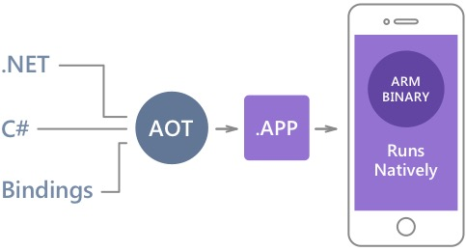
Native Performance
Xamarin.iOS does full Ahead Of Time (AOT) compilation to produce an ARM binary for Apple’s App Store.
Xamarin.Android takes advantage of Just In Time (JIT) compilation on the Android device.
Notes:
There is no compromise on performance.
Xamarin apps look and feel native because they are native.

Slide 36
✓Always Up-to-Date
Same-day support:
iOS 5
iOS 6
iOS 7
iOS 7.1
iOS 8
iOS 9
Full support for:
Apple Watch
Google Glass
Android Wear
Amazon Fire TV
and much more
Notes:
Apple has a developer preview where Xamarin has alphas ready. Google does not offer this.
Android versions are usually 4 to 8 weeks out for a stable release, but alphas and betas are usually earlier.
Xamarin realizes how important having iOS ready because within 24 hours a large portion of iOS users upgrade
Android on the other hand is much different. After 4 months on the market Android 4.4 only had 1% adoption

Slide 37
Code Sharing Stats
iCircuit
Touch Draw
Android
iOS
Mac
Windows Phone
Notes:
iCircuit is made by Frank Krueger, a long time Mono & Xamarin developer.
Sharing code lead to 70 to 90% code reuse across platforms speeding up development
Real-time circuit simulator and editor used to design analog and digital circuits
http://praeclarum.org/post/42378027611/icircuit-code-reuse-part-cinq

Slide 38
What’s new in Xamarin Platform?
Enhanced VS Integration
Xamarin.Forms 2.0
iOS 9 & Android M
Preview
Technologies

Slide 39
Visual Studio Integration Enhancements
Seamless Integration & Setup
Resilient Build Connection
Enhanced iOS & Android Designers
Notes:
Built from the ground up over a secure SSH connection
Build and Connect from multiple instances of Visual Studio
Designers: XIB and Material Design Support & Updates

Slide 40
Xamarin.Forms 2.0
Deep Integrations with iOS 9 and Android Marshmallow
Material Design (AppCompat)
Performance Optimizations
Pre-compiled XAML
Windows 10 (UWP) Preview
New Gestures
Notes:
AppCompat delivers visual beautify across all version of Android
ListView overhaul with amazing optimizations for images and cell recycling
Support for iOS, Android, Windows Phone 8, Win RT Phone/Store 8.1, and Windows 10 UWP
Pull to refresh & Pinch gestures & more to come!

Slide 41
Demo

Slide 42
Preview Technologies
Objective Sharpie
CocoaPod Integration
Profiler
Inspector

Slide 43
Demo

Slide 44
Xamarin – Your Complete Mobile Solution
BUILD
TEST
MONITOR
ACCELERATE
Notes:
Xamarin is your complete mobile solution.
Xamarin Platform is usually what you hear about which is building native iOS, Android, Mac, and Windows Apps all in C#
However Xamarin offers a wide range of products for developers to go mobile including Test Cloud, Insights, and a way to learn all of mobile with University.

Slide 45
Device Fragmentation
App Complexity
Fast Release Cycles
Short Sessions
High Mobile User Expectations
Challenges
Notes:
Well there are several challenges that we must overcome as mobile developers including….

Slide 46
On Mobile, Quality is Hard
7
20
20
35
6
OS versions
Devices
Languages
Locales
Screen sizes
10
24K+
39
57
27
15
6
OS versions
Distinct devices
Languages
Locales
Screen sizes
Manufacturers
Screen configurations
8
Notes:
First let’s take a look at the shear number of configurations there are between iOS and Android. As iOS progresses this number is only set to increase, and on Android it is already a HUGE number of configurations to even think about testing.
iOS: 7, 7.1, 8, 8.1, 8.2, and iOS 9, iOS 9.1

Slide 47
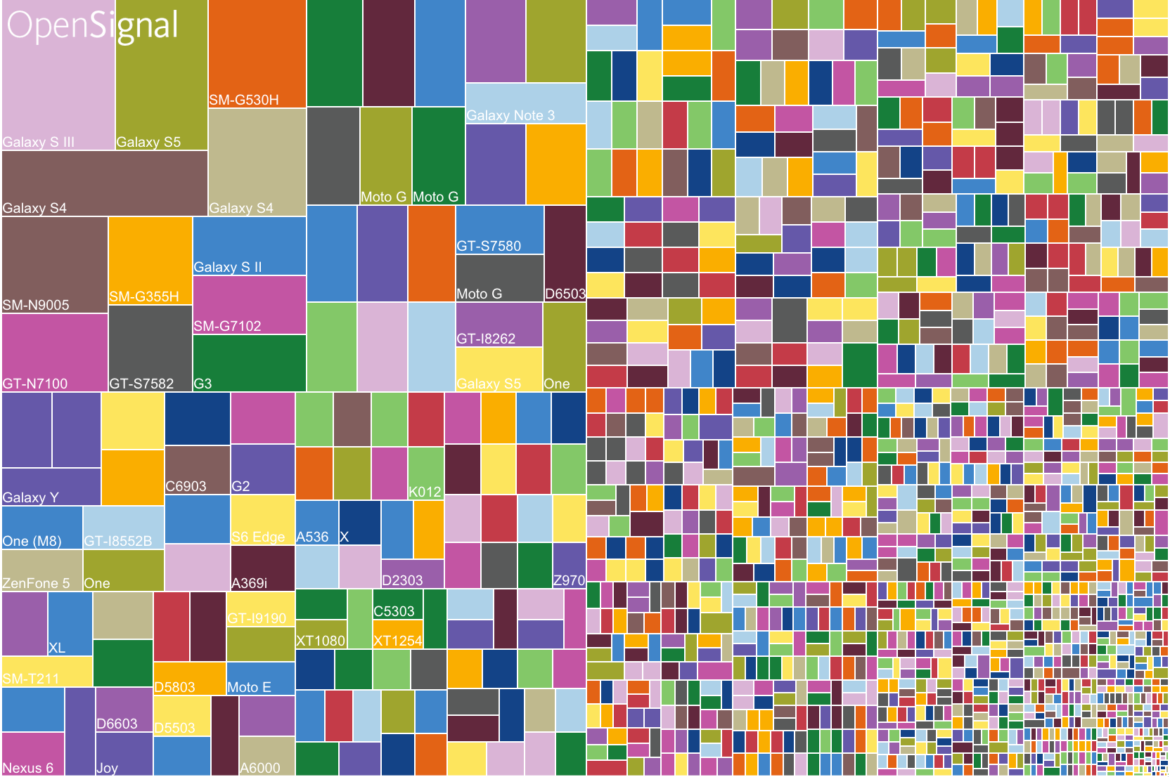
Android diversification

Slide 48
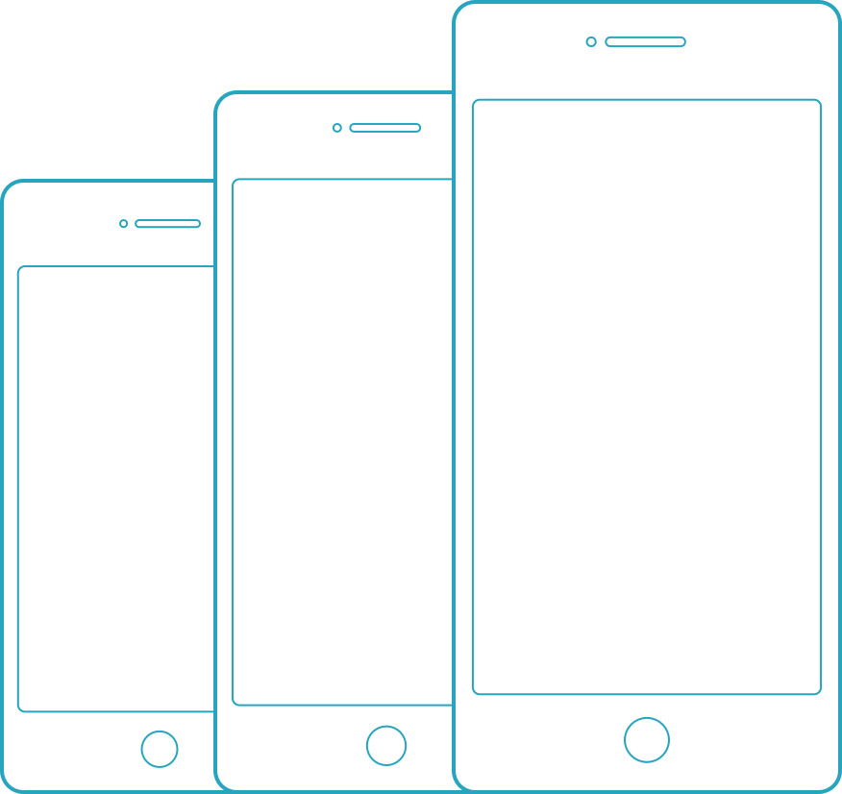
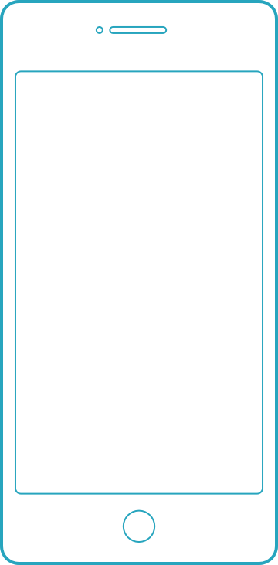
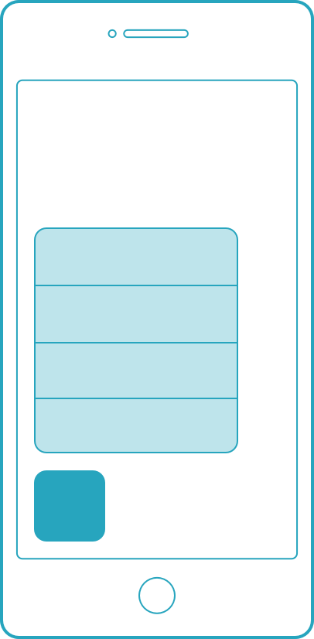
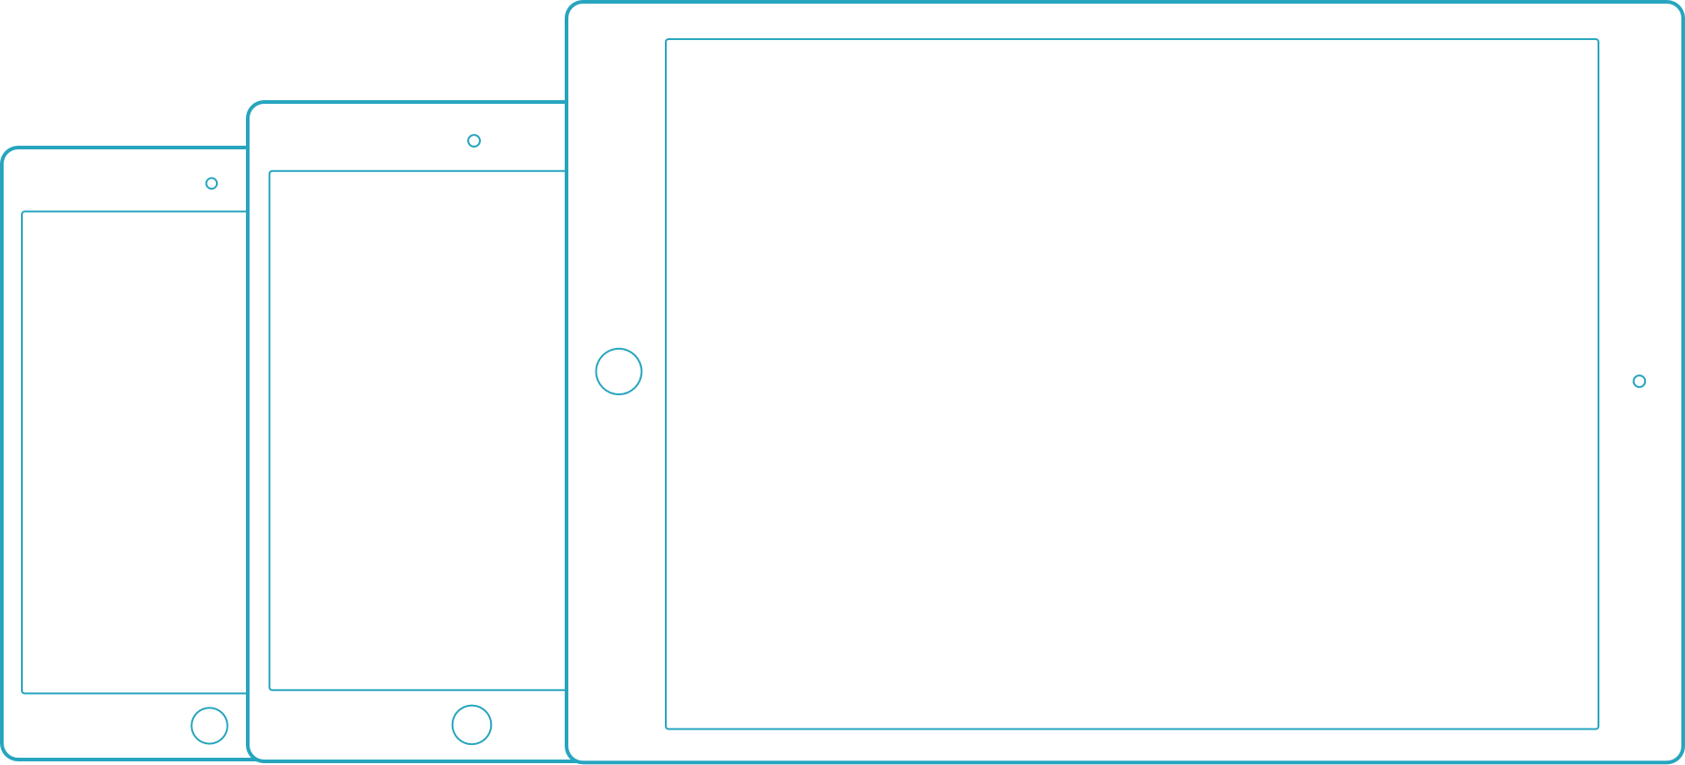
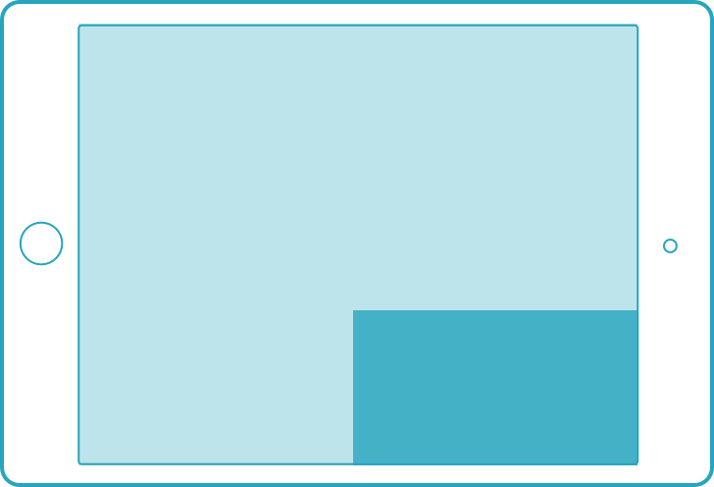
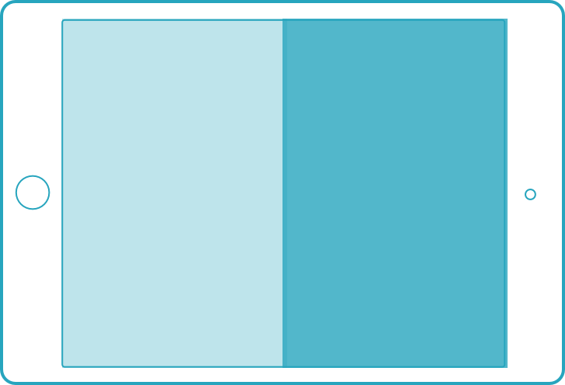
iOS diversification
3D Touch
Apple pencil
iPhones
iPod touch
iPad Pro only
iPhone 6s series only
iPads
Multi Tasking
Only select iPads
Form factors
iOS 9 features

Slide 49
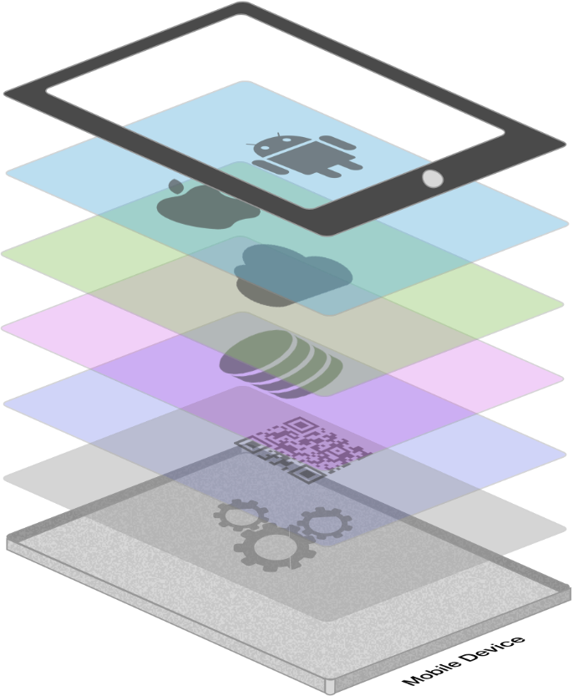







App Complexity
Thousands of iOS and Android APIs
Public web APIs
Backend integrations
Third party libraries
Memory, CPU and network constraints
Notes:
The fragmentation isn’t just in the devices, but as we start to build on our applications you soon found out they are ever increasingly complex.

Slide 50








Tap
Scroll
Swipe
Pinch
Multi Finger
Text Entry
Rotation
GPS
Notes:
With a simple command you can simulate all of your users interactions to build out a great test suite that can be run over and over again.

Slide 51
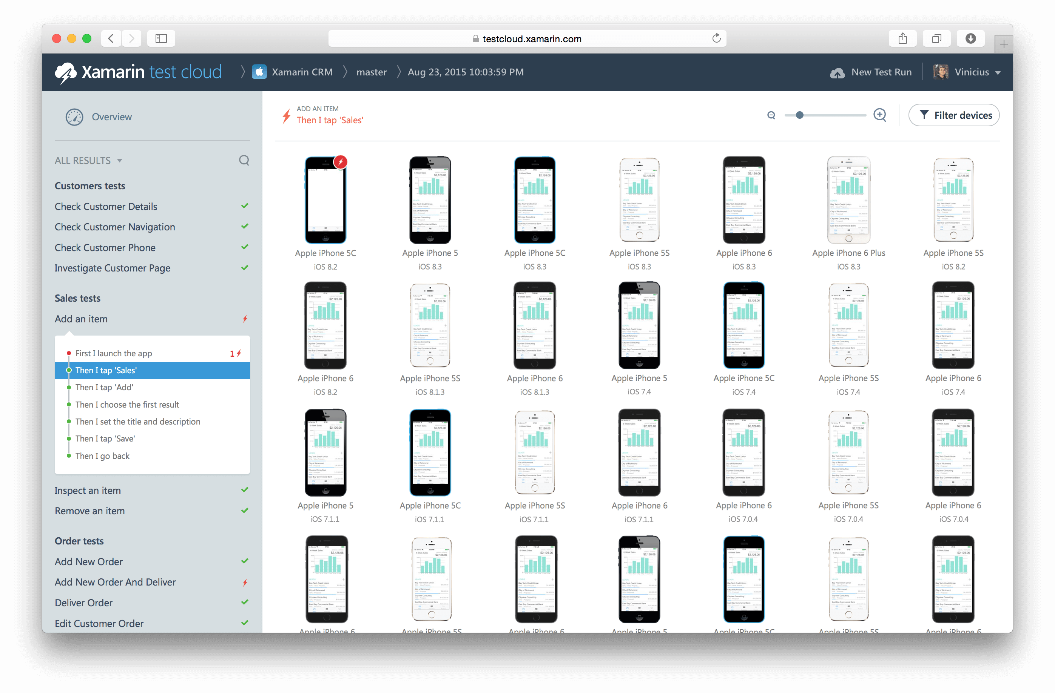
Xamarin Test Cloud: automated testing on thousands of devices

Slide 52
What’s new in Xamarin Test Cloud?
Integrated with Platform
UITest 1.0
Test Recorder
Notes:
Integrated:
-New app templates & easily upload to Test Cloud
UITest 1.0
-Unlimited test runs for free on simulator or local device!
Test Recorder
-Easily create tests with a tap of your app
-Copy out test or upload to test cloud

Slide 53
Demo

Slide 54
Xamarin – Your Complete Mobile Solution
BUILD
TEST
MONITOR
ACCELERATE
Notes:
Xamarin is your complete mobile solution.
Xamarin Platform is usually what you hear about which is building native iOS, Android, Mac, and Windows Apps all in C#
However Xamarin offers a wide range of products for developers to go mobile including Test Cloud, Insights, and a way to learn all of mobile with University.

Slide 55
Xamarin Insights – Real-time monitoring
Supports
✓ Xamarin.iOS
✓ Xamarin.Android
✓ Xamarin.Mac
✓ Windows Phone
✓ Windows Store
✓ Windows Desktop
Notes:
Xamarin.Insights, currently in preview, enables us to support all of our apps from a full cross platform API.

Slide 56
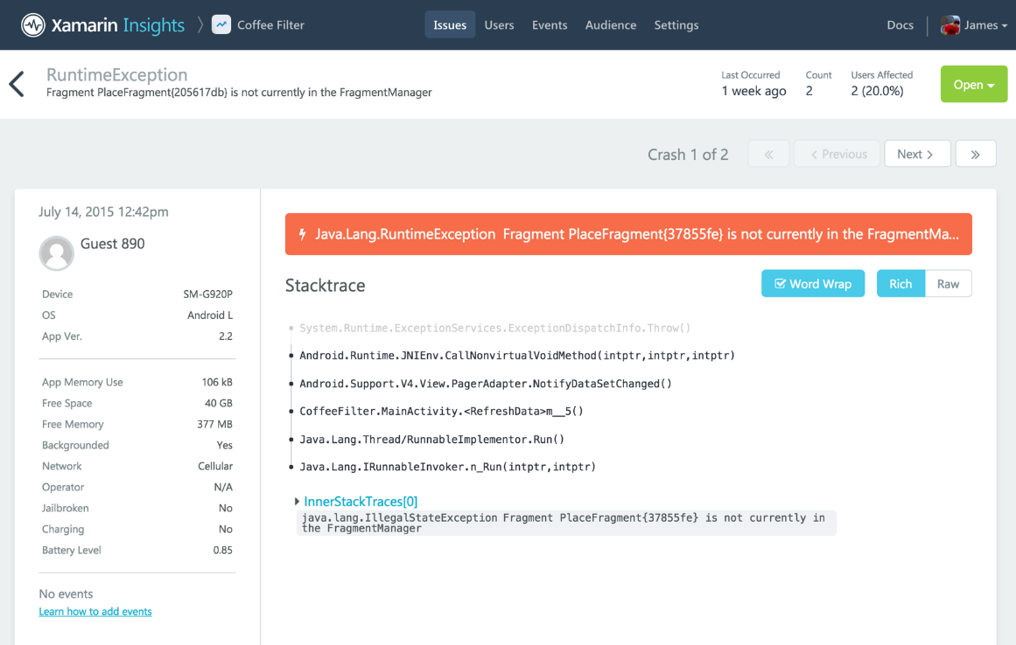
Xamarin Insights – Report
Automatically report any uncaught managed or native exception.
Report your own caught exceptions with simple cross-platform API.

Slide 57
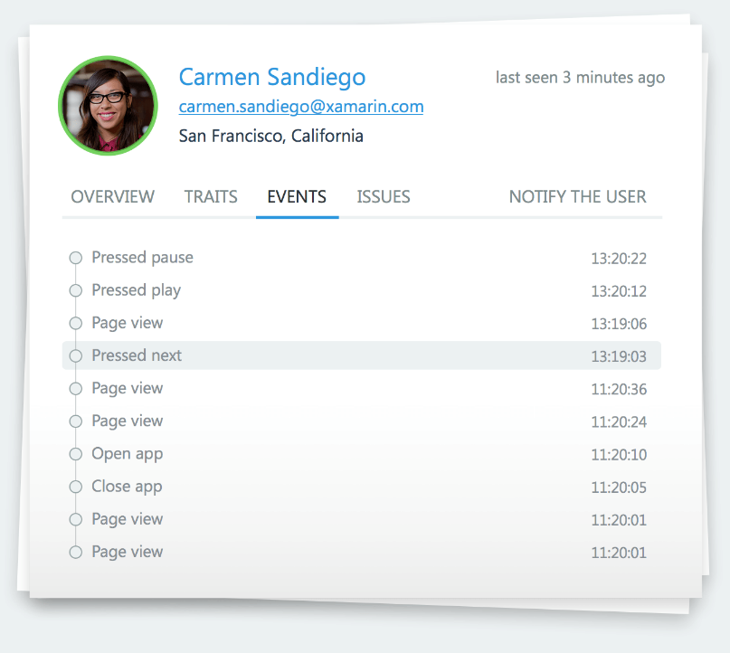
Xamarin Insights – Track
Track any event that occurs in your application.
Even track performance of how long an operation takes.

Slide 58
Xamarin Insights – Identify
Combine event tracking with user identification to resolve issues faster.

Slide 59




Xamarin Insights – Integrate
Simple integrations into popular services
for mission critical notifications.
Notes:
Xamarin.Insights, currently in preview, enables us to support all of our apps from a full cross platform API.

Slide 60
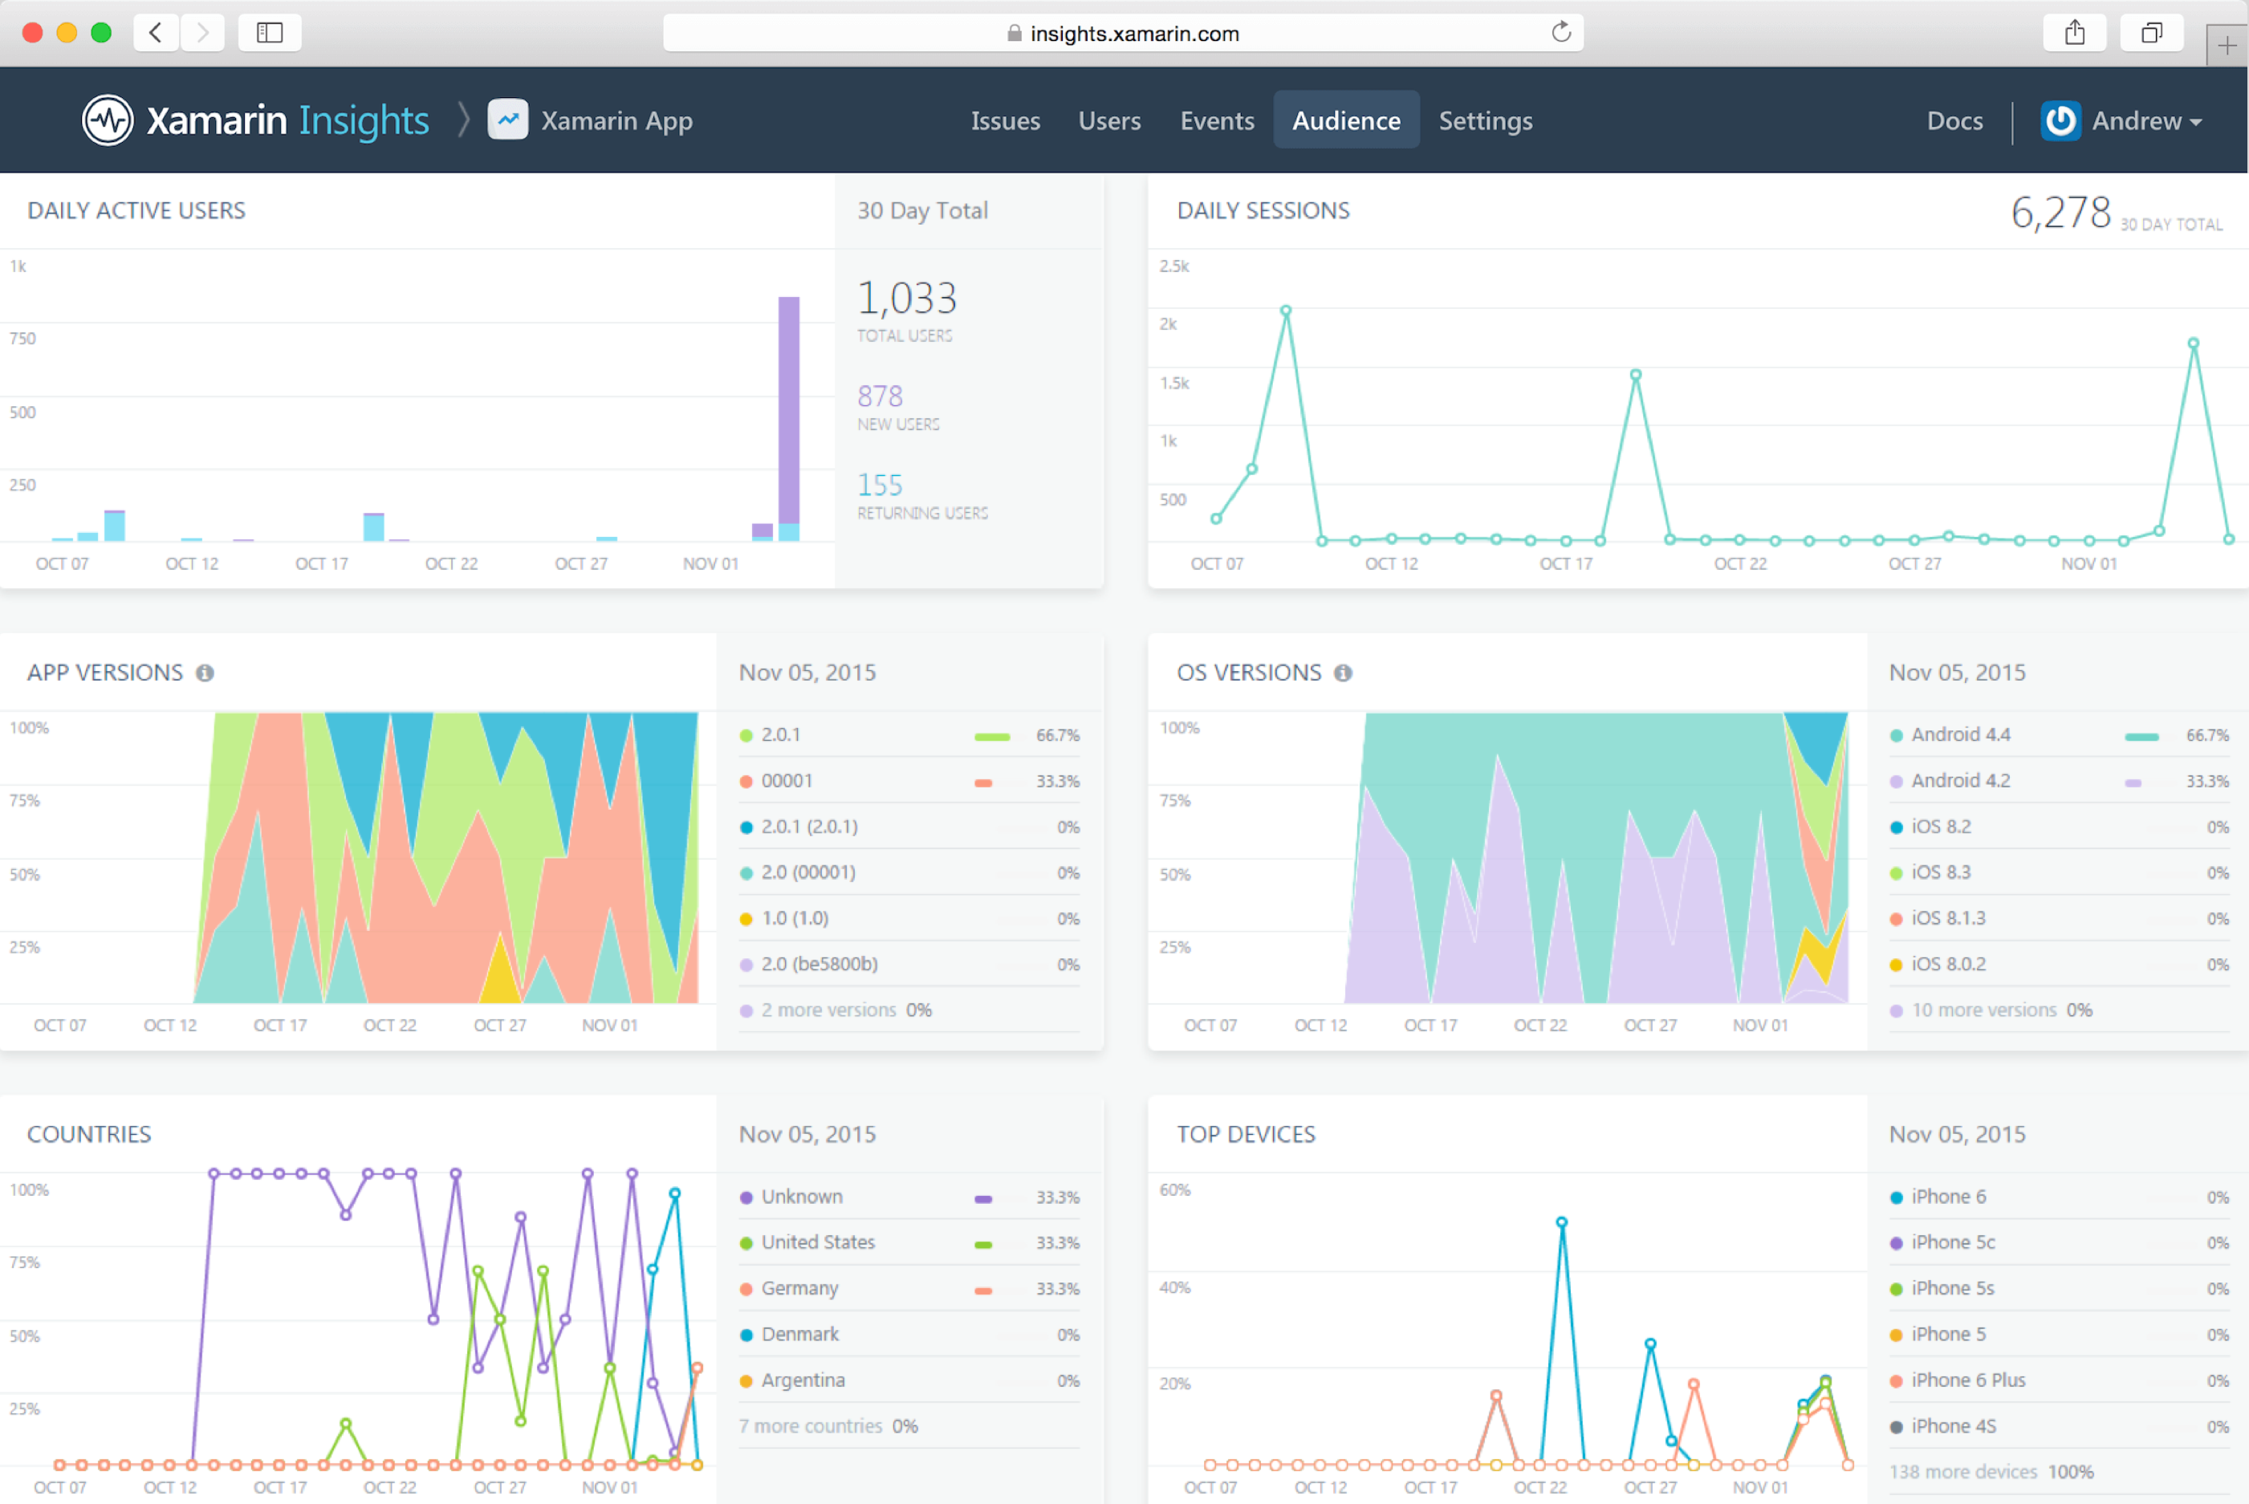
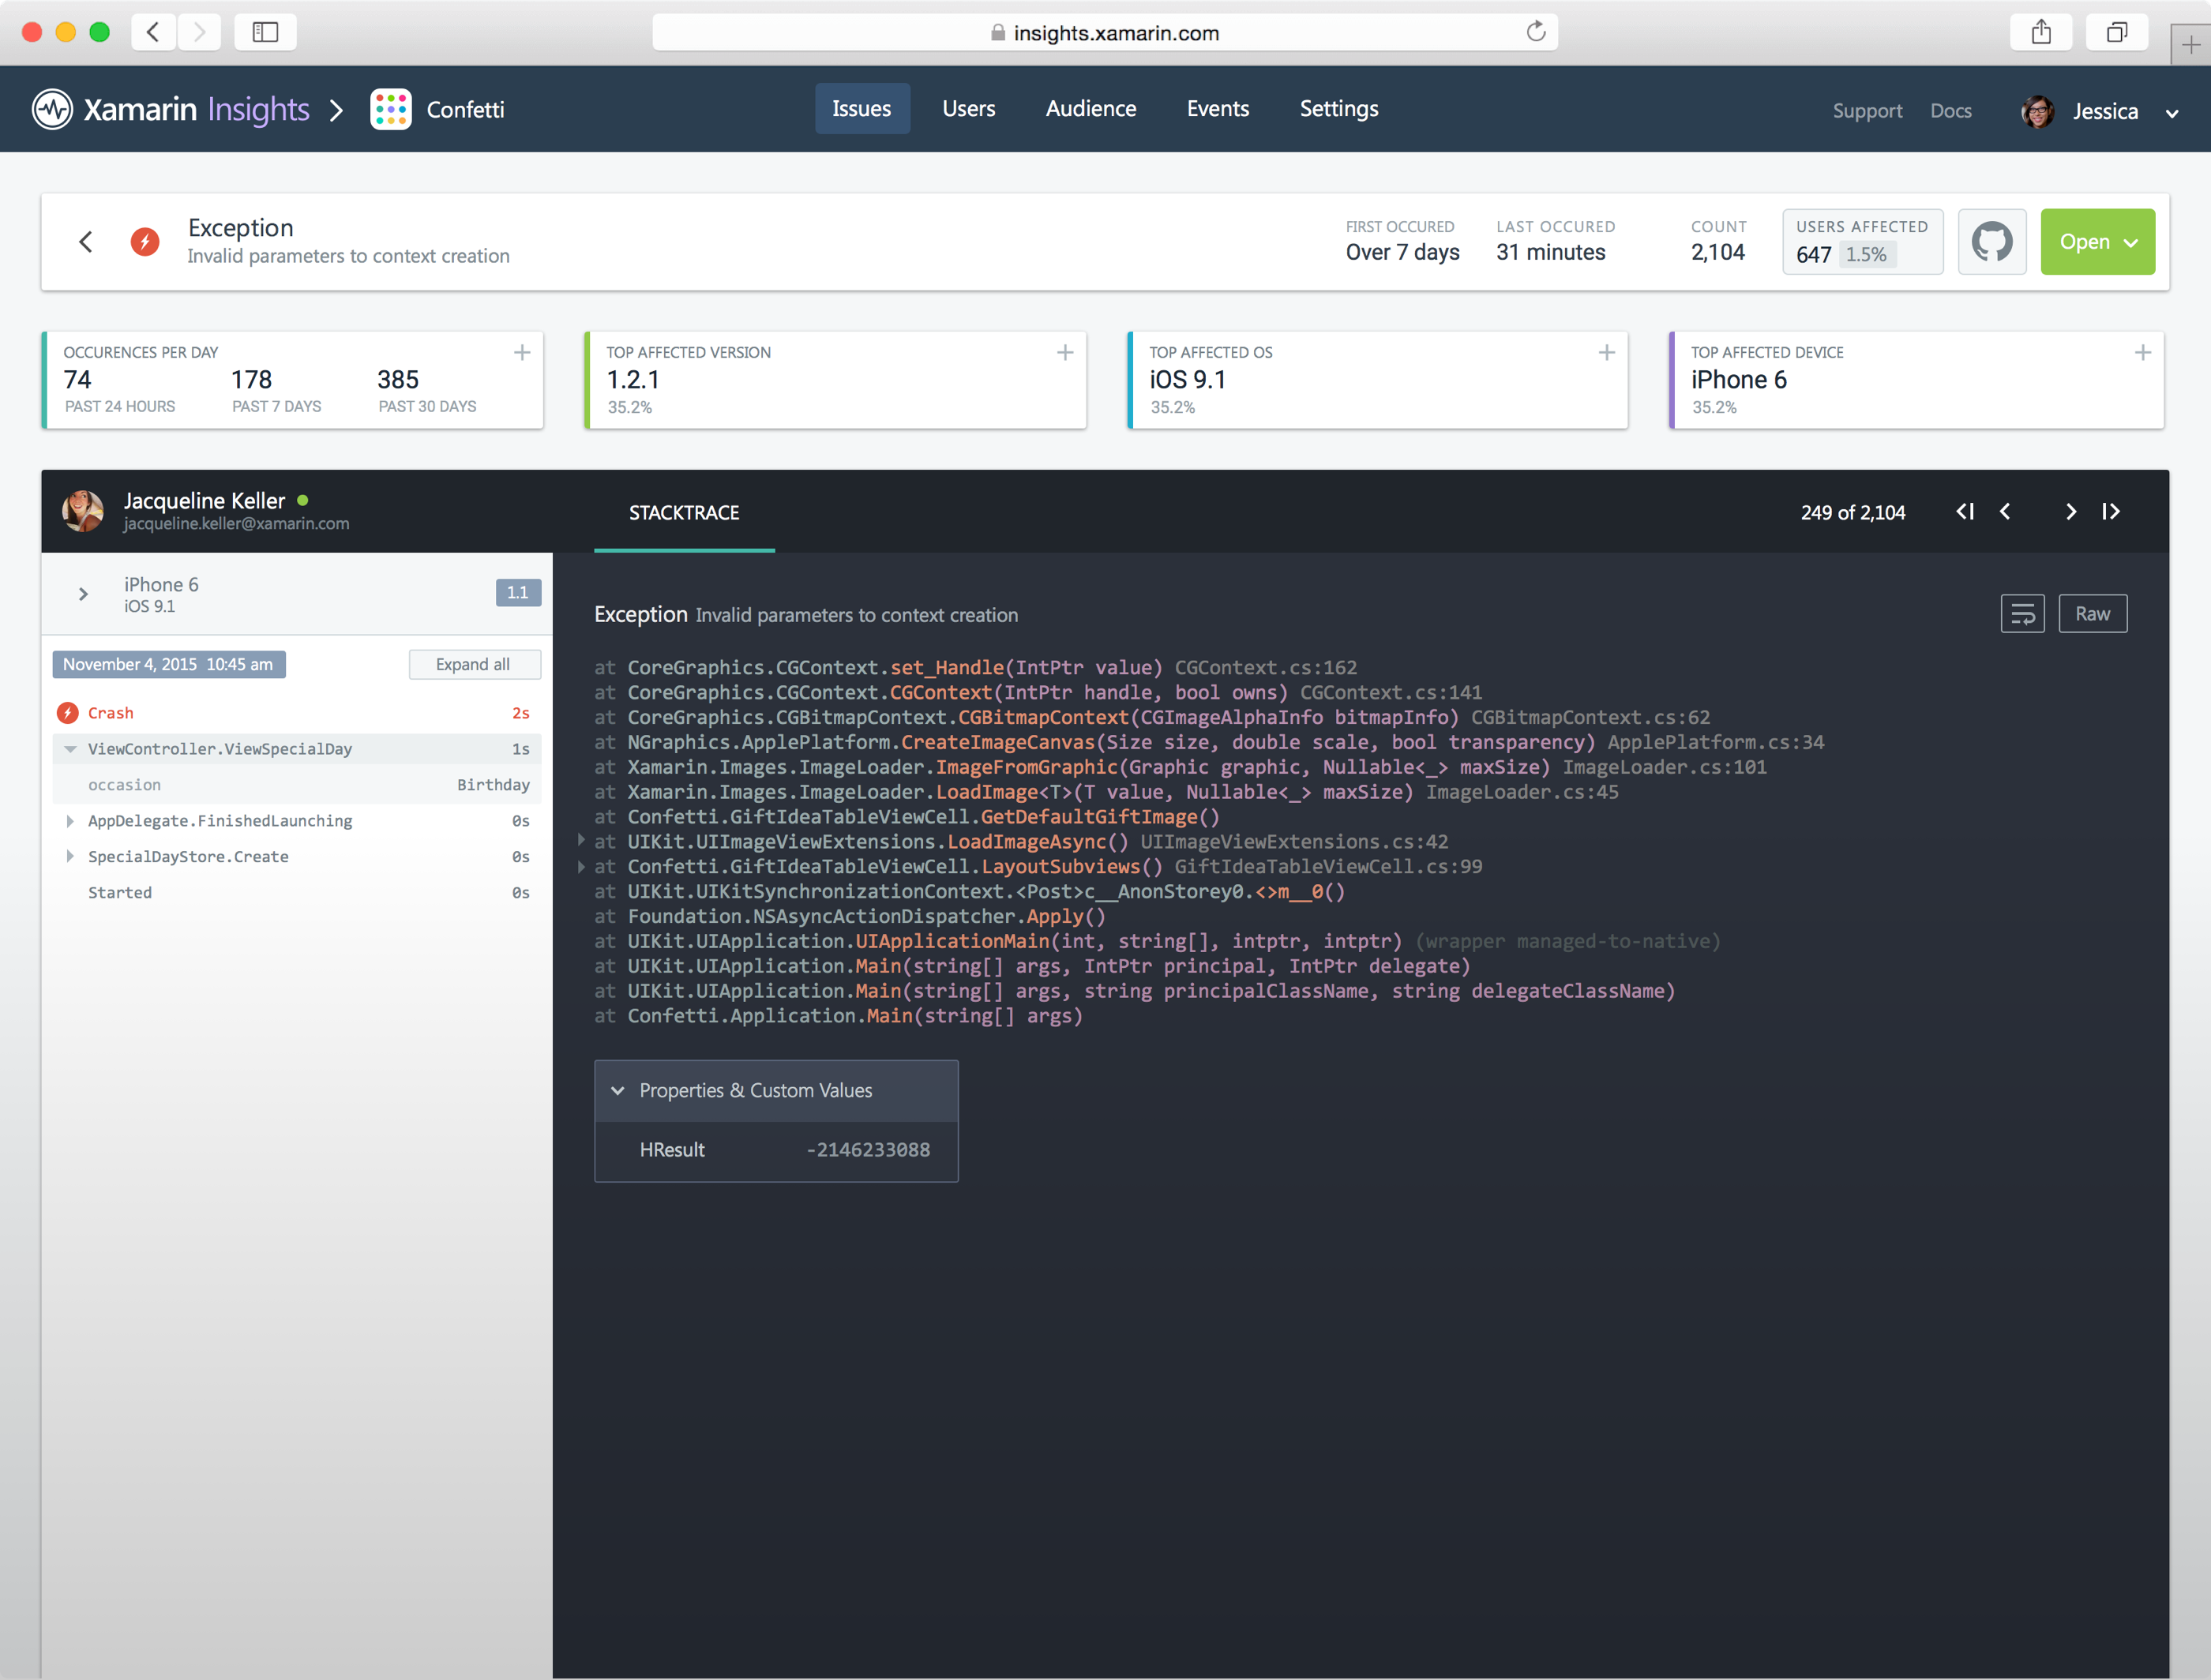
Introducing Xamarin Insights
//Crash Report
Insights.Report(exception);
//Feature Usage
Insights.Track(“Splash Page”);
//Timed Events
Insights.TrackTime(“TimeToSync”);
//User Sessions
Insights.Identify(“Steve”, user_traits);

Slide 61
Demo

Slide 62
Xamarin – Your Complete Mobile Solution
BUILD
TEST
MONITOR
ACCELERATE
Notes:
Xamarin is your complete mobile solution.
Xamarin Platform is usually what you hear about which is building native iOS, Android, Mac, and Windows Apps all in C#
However Xamarin offers a wide range of products for developers to go mobile including Test Cloud, Insights, and a way to learn all of mobile with University.

Slide 63
What’s Xamarin University?
Over 60 classes
Guest Lectures and office hours
Lightning Lectures: Bite size learning on specific topics
Certification: Be recognized
for being a
Mobile and
Xamarin expert
Reduced renewal pricing

Slide 64
Xamarin – Your Complete Mobile Solution
BUILD
TEST
MONITOR
ACCELERATE
Notes:
Xamarin is your complete mobile solution.
Xamarin Platform is usually what you hear about which is building native iOS, Android, Mac, and Windows Apps all in C#
However Xamarin offers a wide range of products for developers to go mobile including Test Cloud, Insights, and a way to learn all of mobile with University.

Slide 65
Every Xamarin Platform Subscription Includes:
Unlimited Crash Reporting from Xamarin Insights
With 30 day data retention & detailed issue reports
60 Xamarin Test Cloud Device Minutes per Month
Complete Access to Xamarin.UITest
Including tests of unlimited duration running on simulator or local device
30-day trial pass to Xamarin University
Including access to guest lectures & introductory courses

Slide 66
Get Started Today
xamarin.com
Notes:
Get started today with free 30 day trial of Xamarin at xamarin.com

Slide 67
Unrivaled Mobile Development Training
Live unlimited mobile development training from mobile experts, in your time-zone, on your schedule, and as often as you'd like.
Free 30 Day Trial - xamarin.com/university

Slide 68

evolve.xamarin.com

Slide 69
Thank You! Questions?
Hardik Mistry
Technology Consultant
mistryhardik.05@live.com
@mistryhardik05

